Slide 1
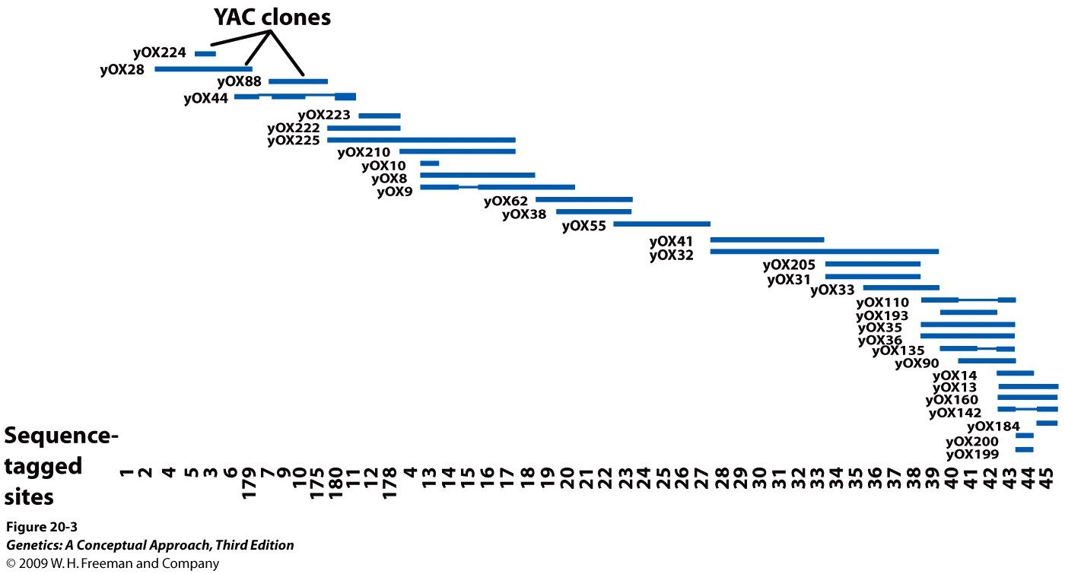
Physical map: by DNA basepairs
Notes:
Figure 20.3 Physical maps are often used to order cloned DNA fragments. A part of a physical map of a set of overlapping YAC clones from one end of the human Y chromosome.

Slide 2
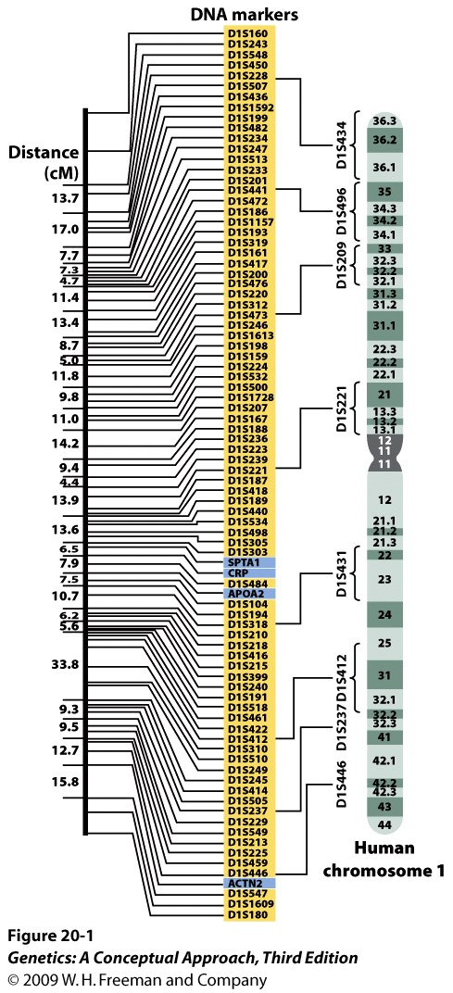
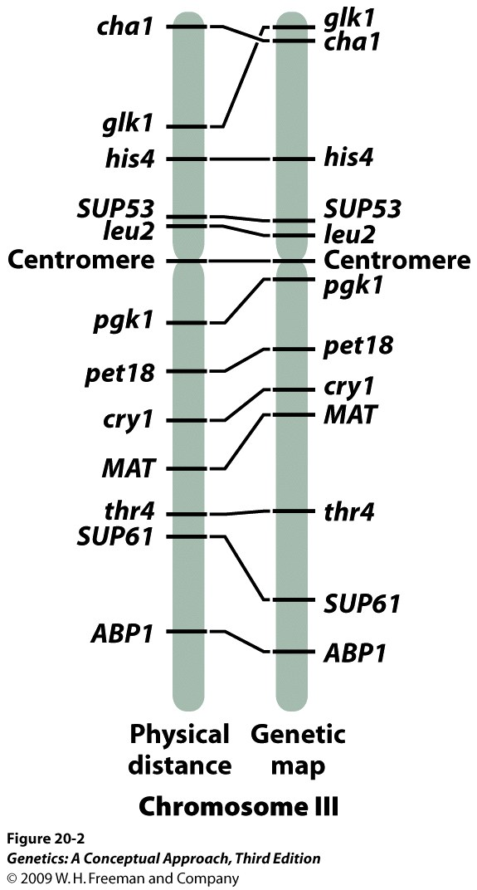
Genetic map: by recombination frequency

Slide 3
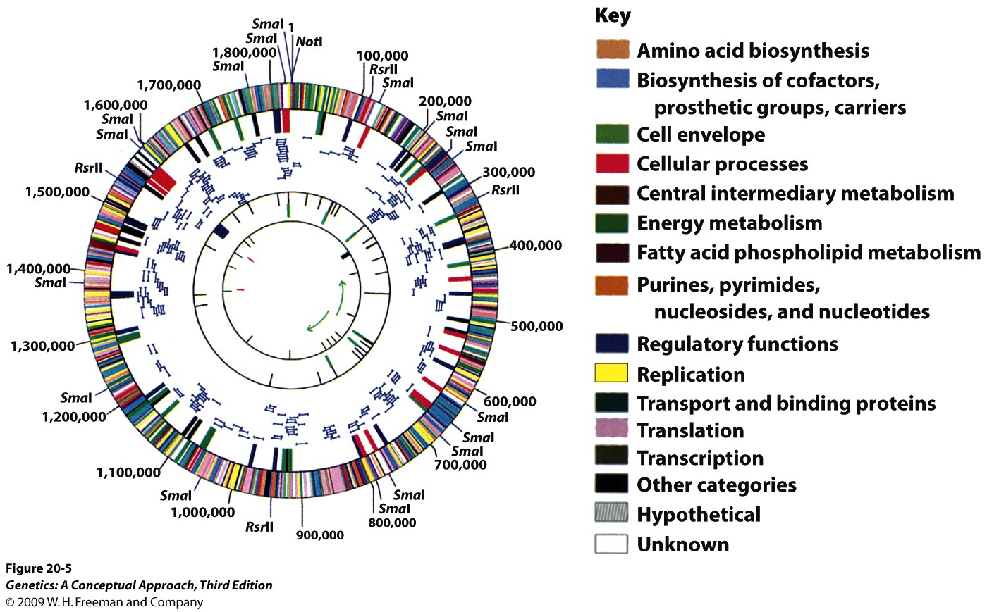
First free-living organism sequenced: Influenza virus
Notes:
Figure 20.5 The bacterium Haemophilas influenzae was the first free-living organism to be sequenced. [From R. D. Fleischman et al., Science 269(1993):496; scan courtesy of TIGR.]

Slide 4
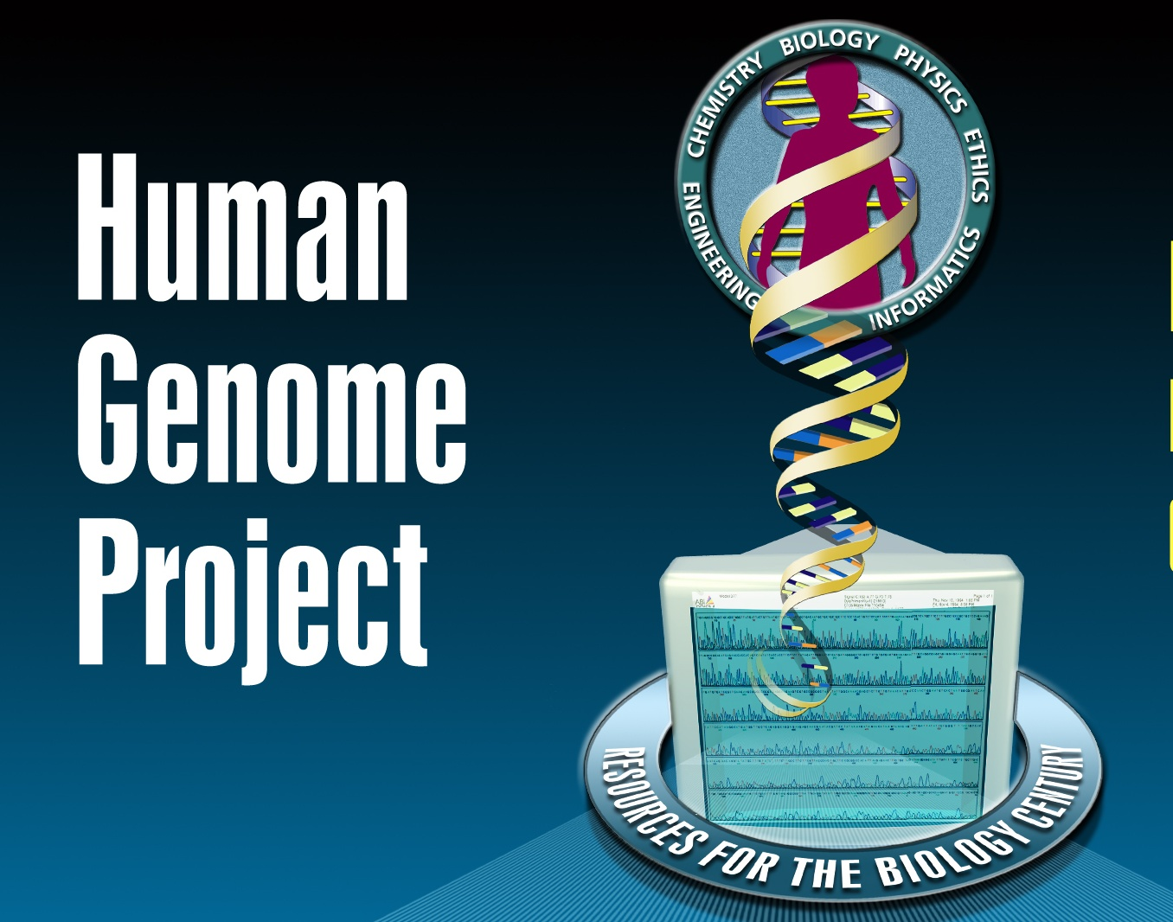

Slide 5
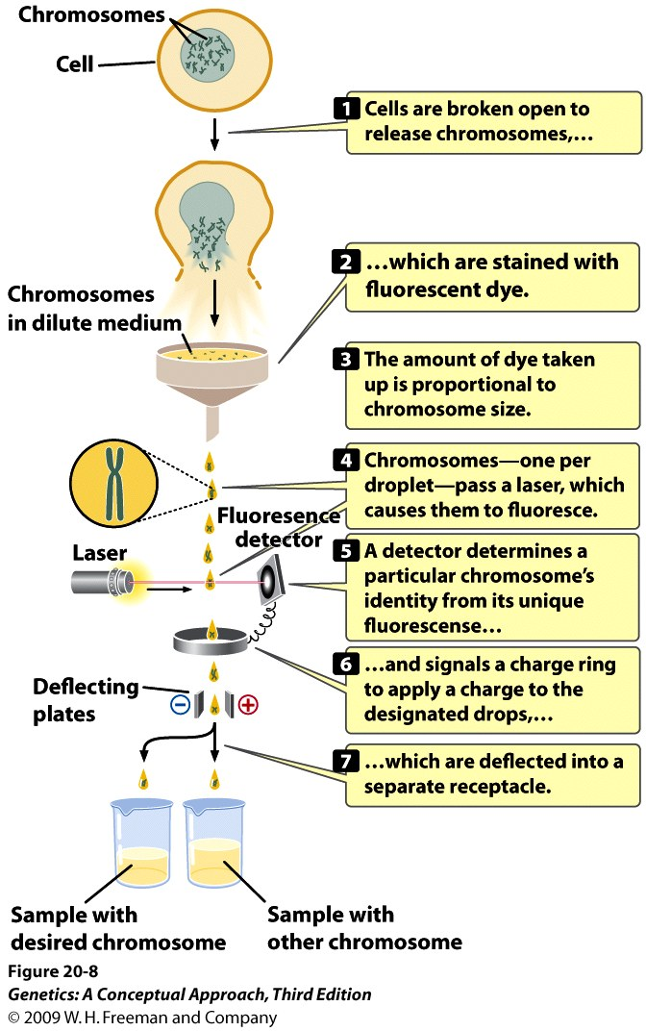
Map-based (directed) sequencing
Notes:
Figure 20.8 Flow cytometry is used to separate individual chromosomes.

Slide 6
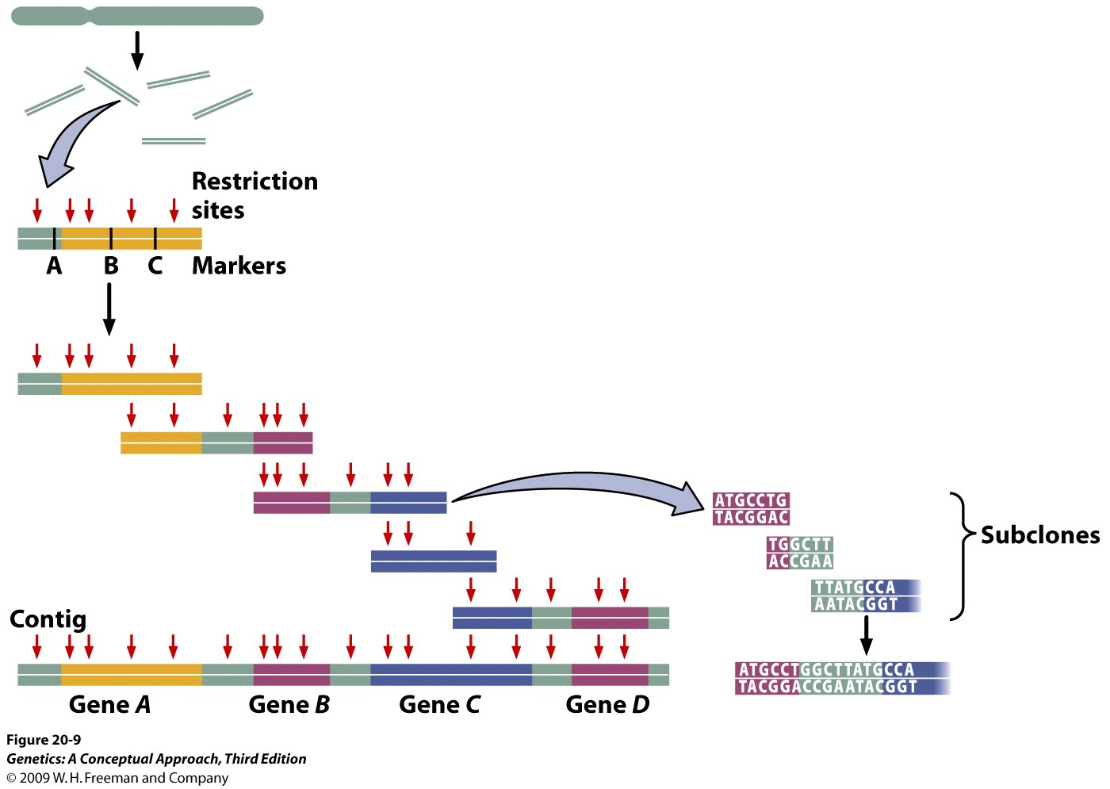
Map-based (directed) sequencing
Notes:
Figure 20.9 Map-based approaches to whole-genome sequencing rely on detailed genetic and physical maps to align sequenced fragments.

Slide 7
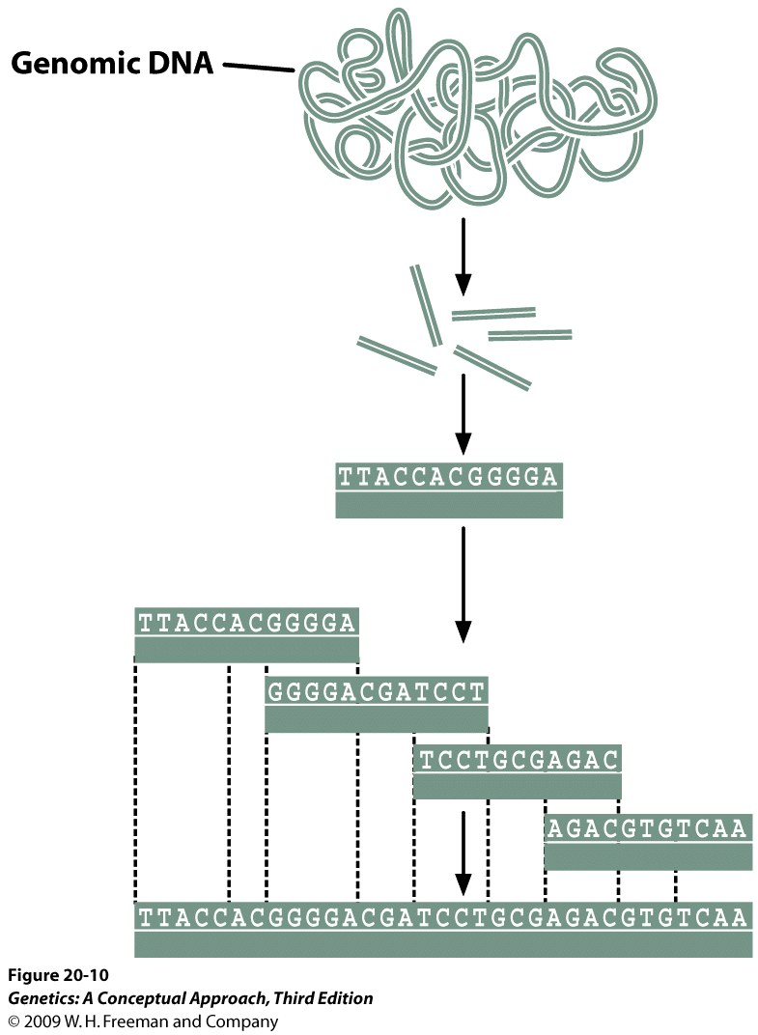
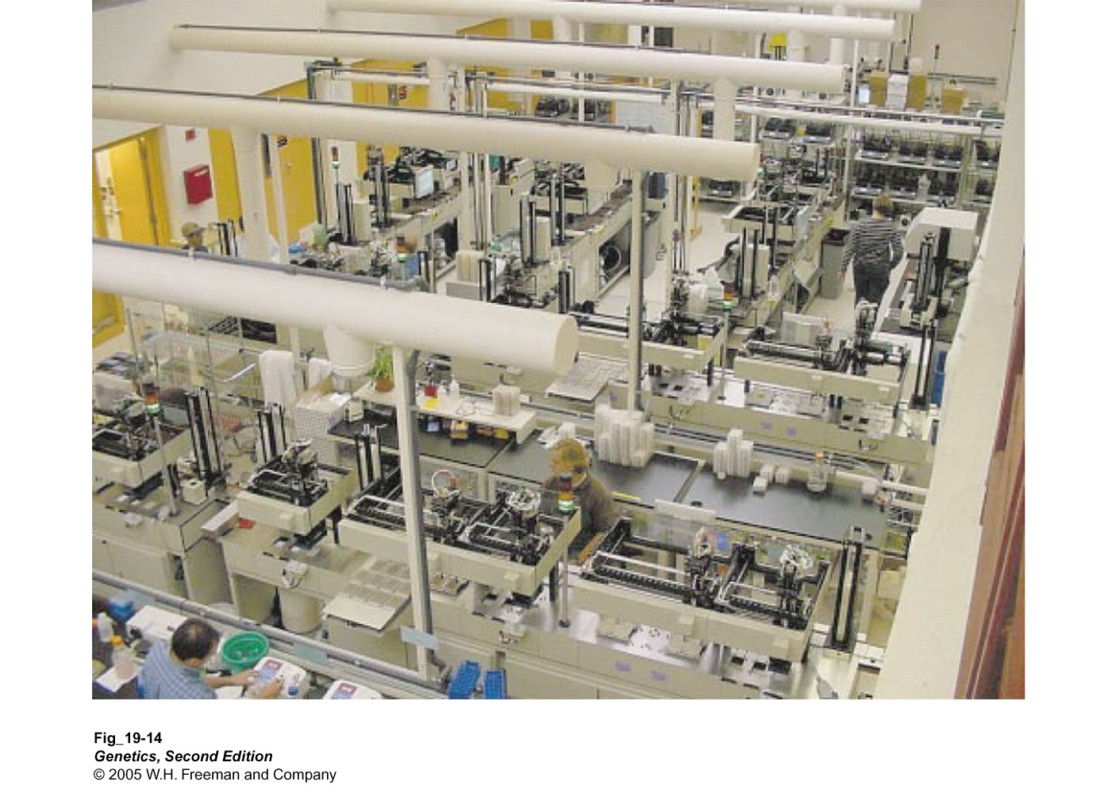
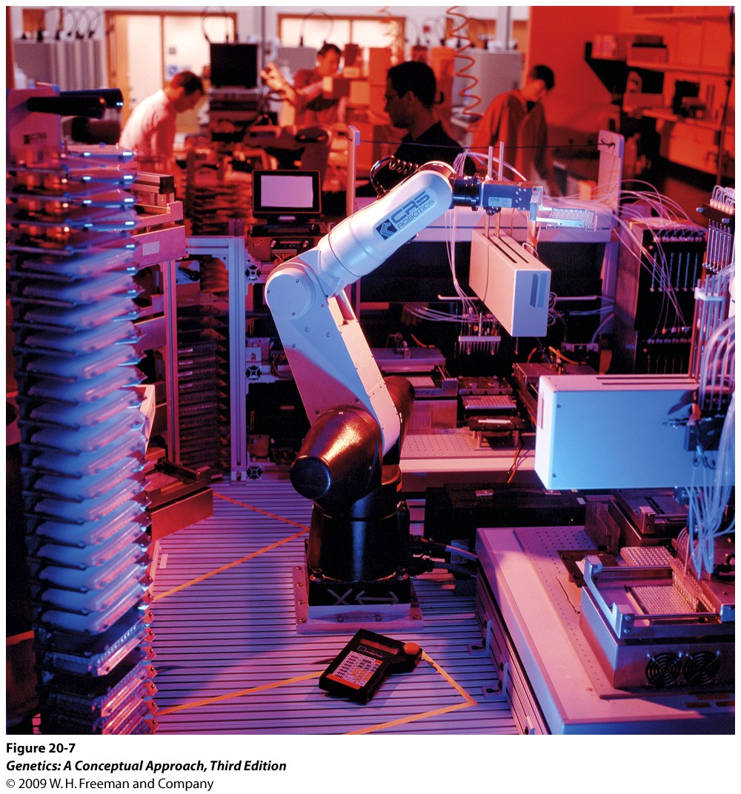
Shotgun sequencing
Notes:
Figure 20.10 Whole-genome shotgun sequencing utilizes sequence overlap to align sequenced fragments.

Slide 8
Steps in sequencing a genome
Shotgun cloning
Sequencing clones
Assembly (compiling) of contigs
Annotation – finding genes
Finishing – filling gaps

Slide 9
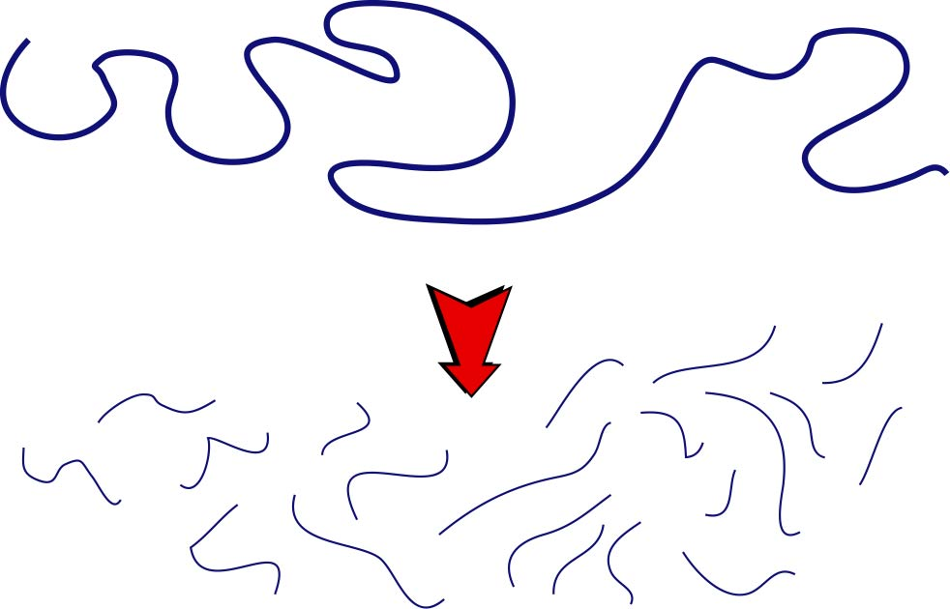
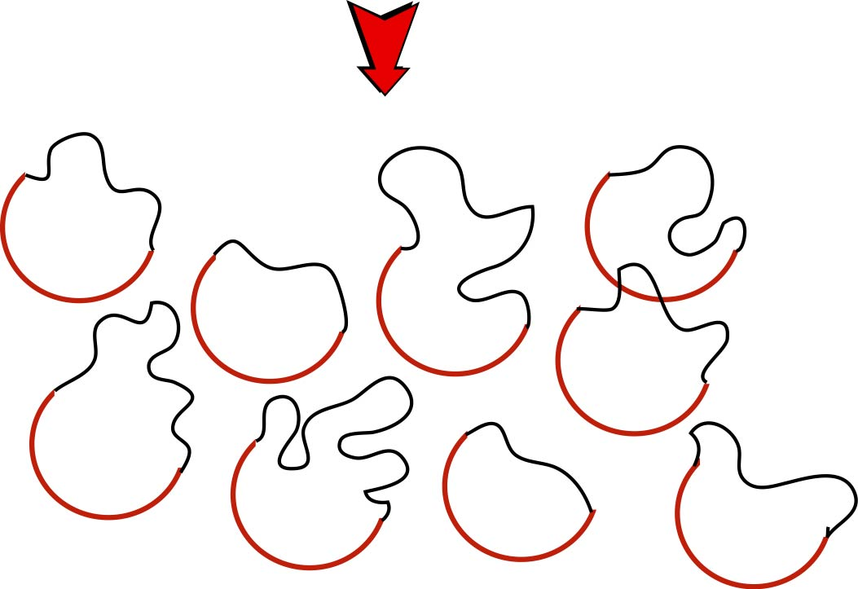
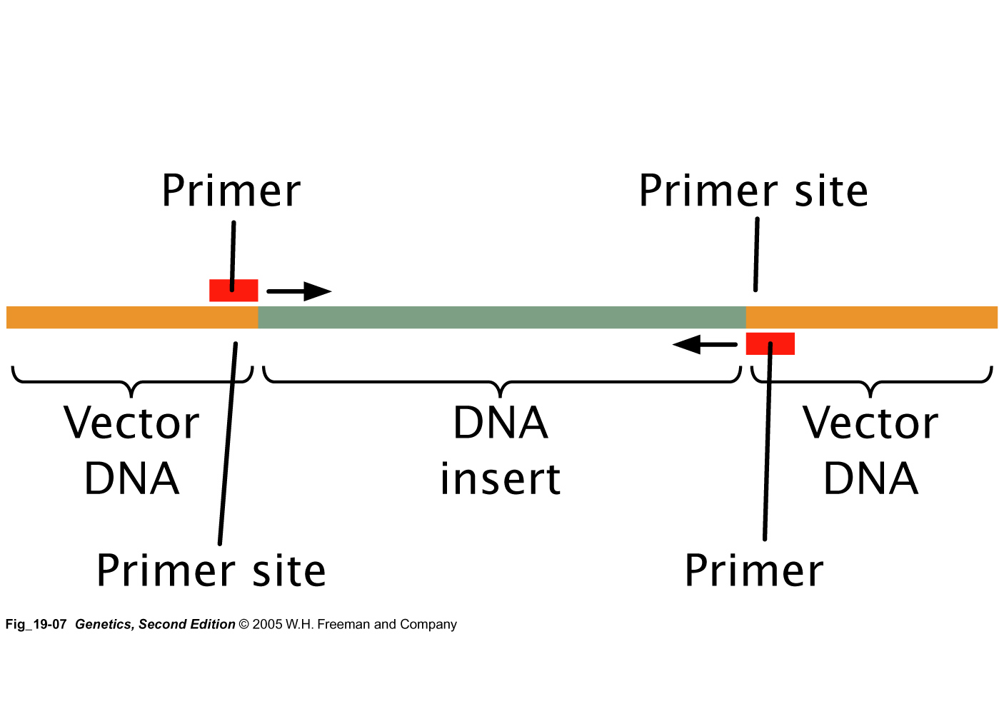
1. Fragments for sequencing
Generally use 2–10 kb pieces for sequencing
Clone into sequencing vector
Contains binding sites for sequencing primers
digestion or sonication

Slide 10
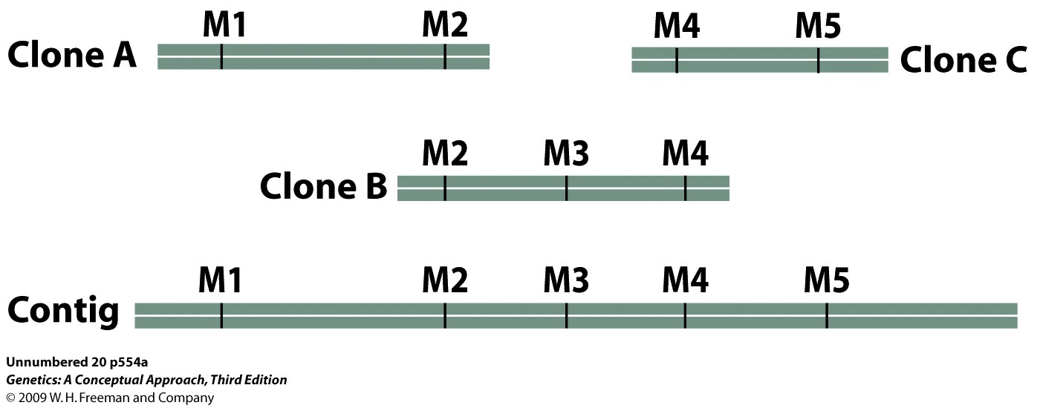
3. Assembly (compilation) of contigs
Start with one contig = one cloned insert
Assemble raw sequence reads into accurate contiguous sequence
Partly a Manual process
Look at sequence reads at positions where programs can’t tell which base is the correct one
Fill gaps
Ensure adequate coverage
End up with one contig = one chromosome
Gap
Single
stranded

Slide 11
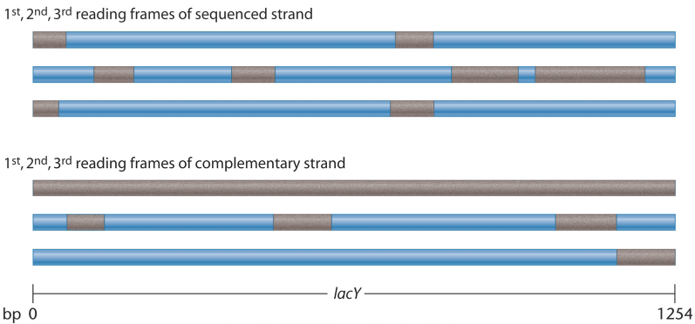
4. Annotation
A. Finding ORFs (open reading frames) – the easy part

Slide 12
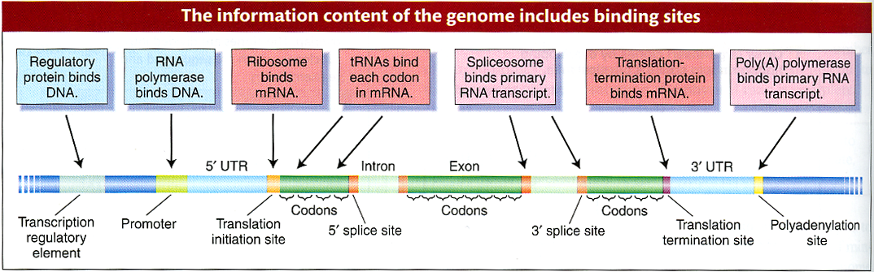
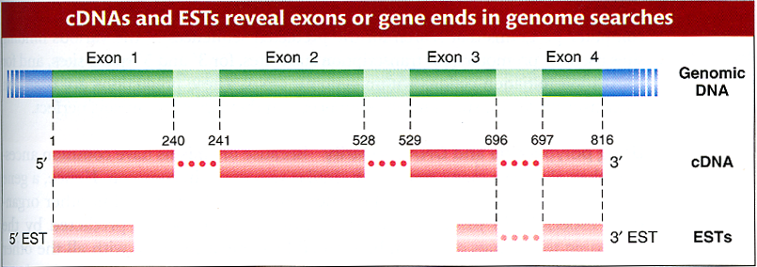
How to find a gene?

Slide 13
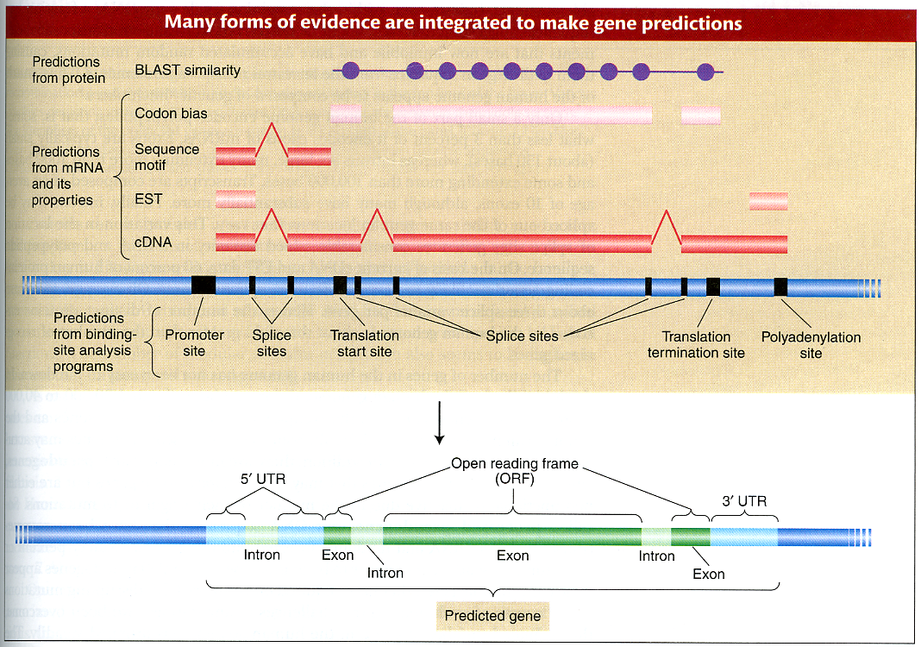

Slide 14
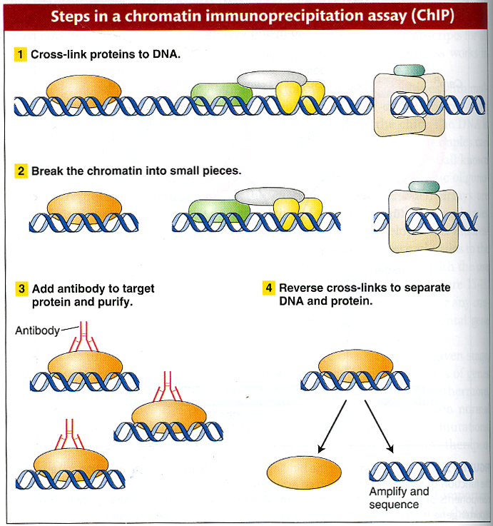
Use ChIP to find the binding sites for a DNA-binding protein

Slide 15
5. Finishing
To fill gaps in sequence, design primers and sequence from primer
To ensure adequate coverage, find regions where there is not sufficient coverage and use specific primers for those areas
GAP
Primer
Primer

Slide 16
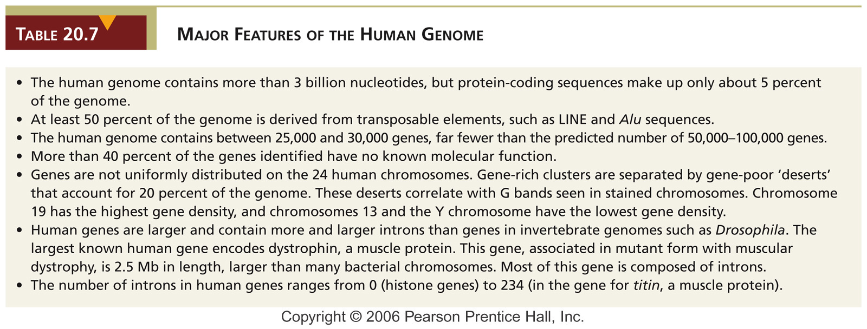
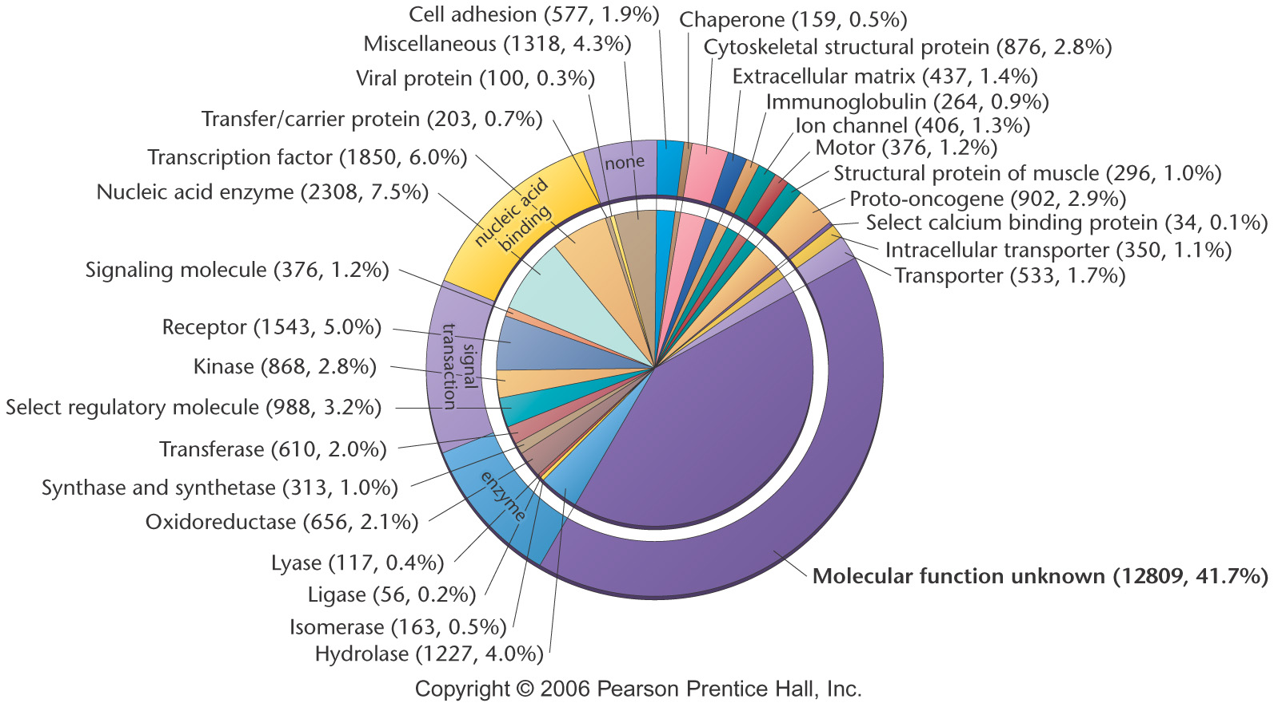
Notes:
Table 20-7 Major Features of the Human Genome

Slide 17
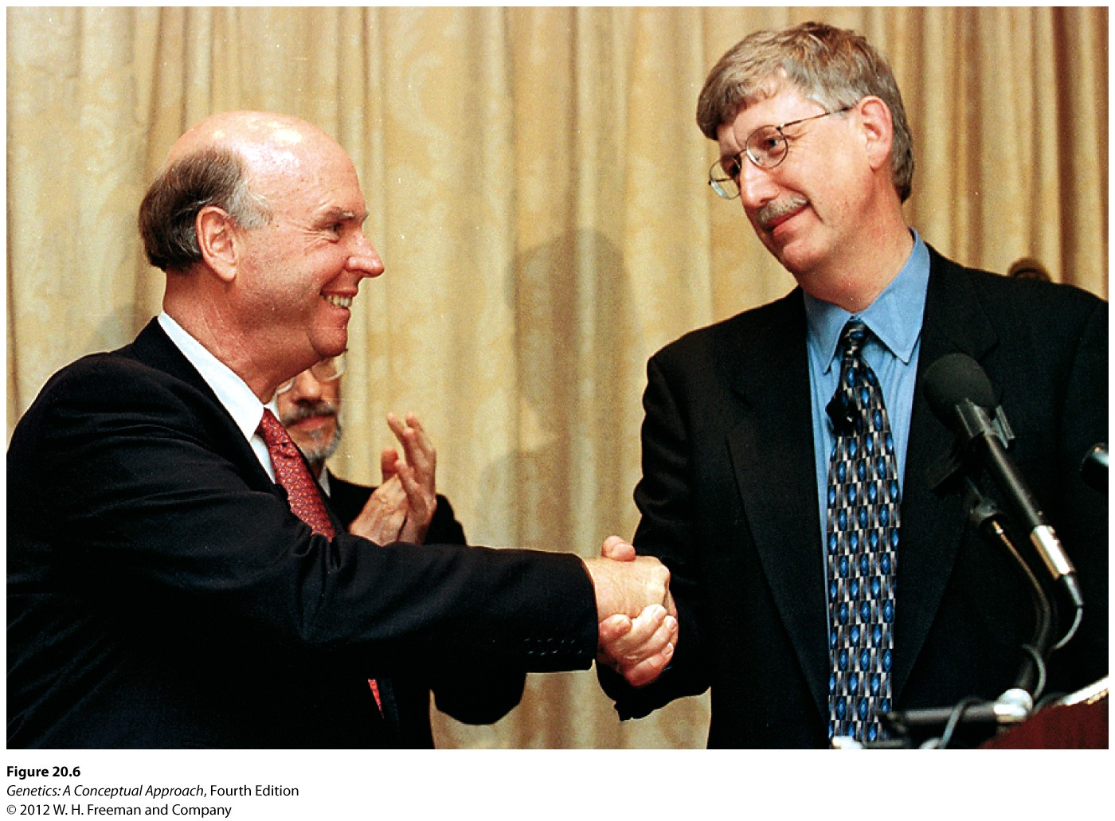

Slide 18
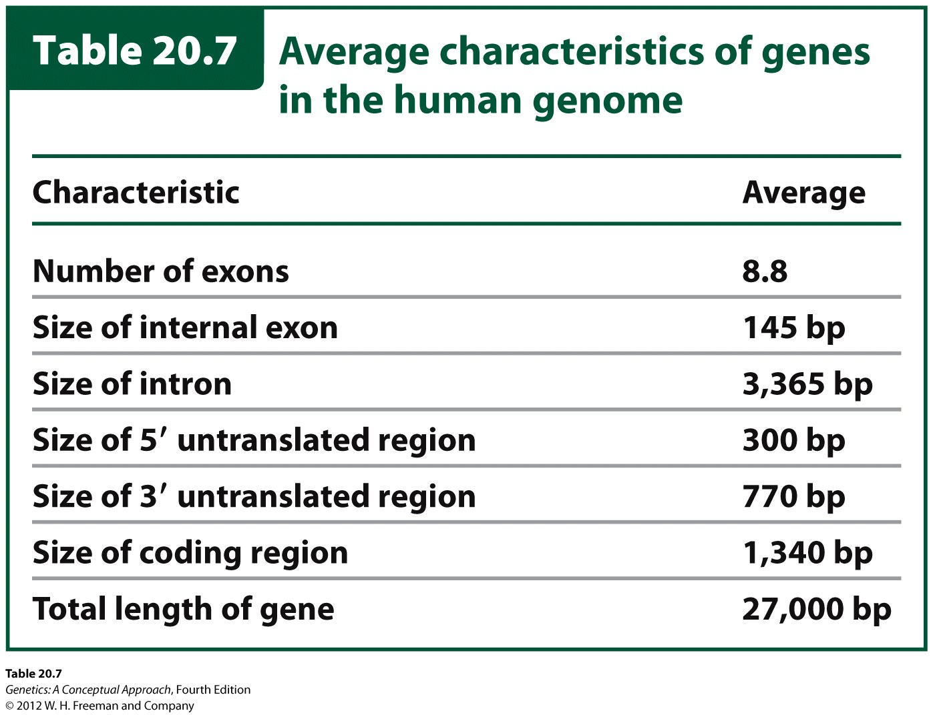

Slide 19
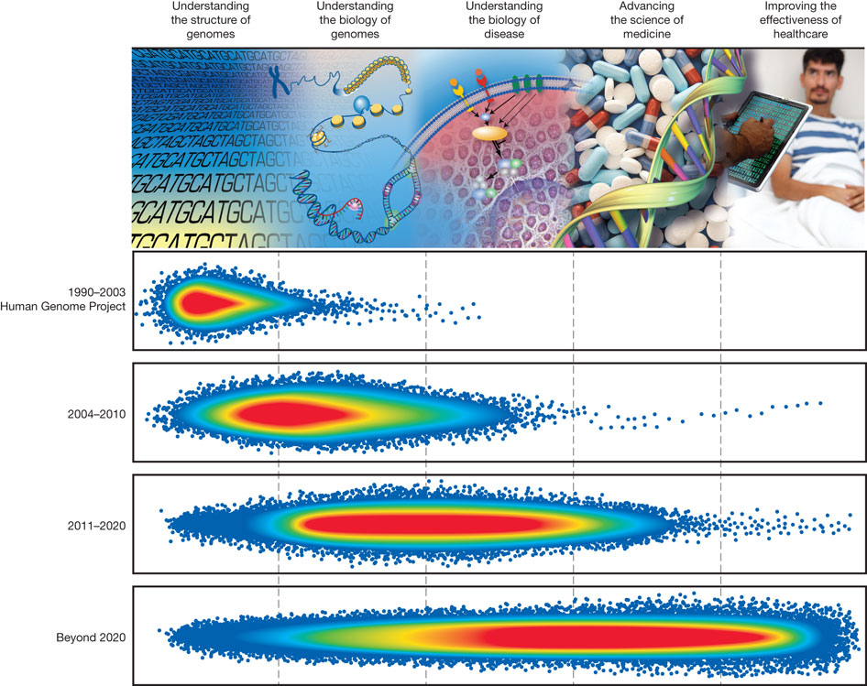

Schematic representation of accomplishments across five
domains of genomics research
E D. Green et al. Nature 470, 204-213 (2011) doi:10.1038/nature09764

Slide 20
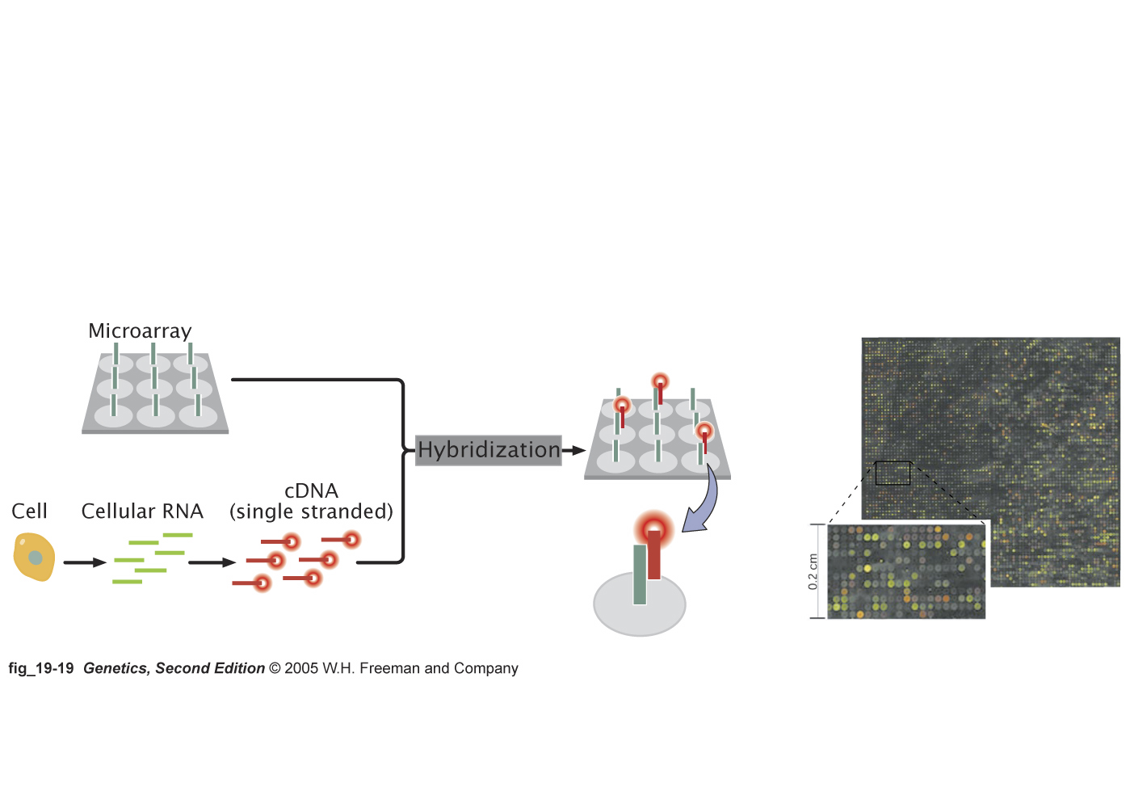
Microarray (Gene chip) is a powerful tool for analyzing
the expression profile of the entire genome

Slide 21
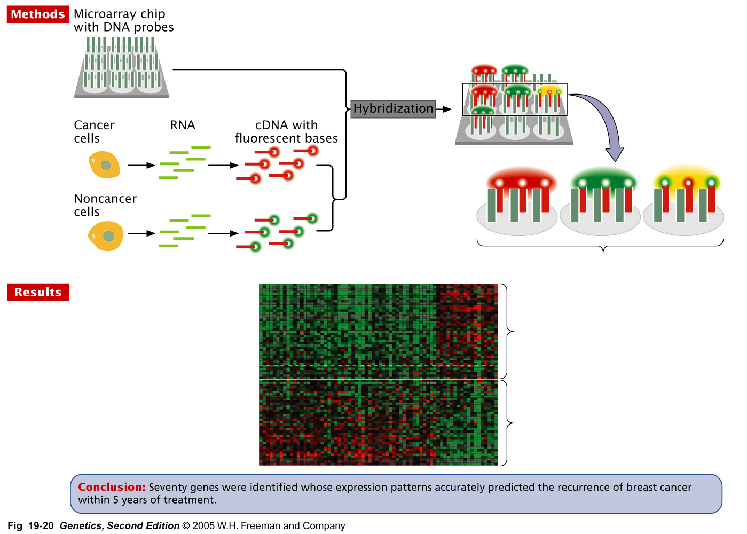
Example: Using microarray to detect the differences in
gene expression between normal and cancer cells

